Slide 1
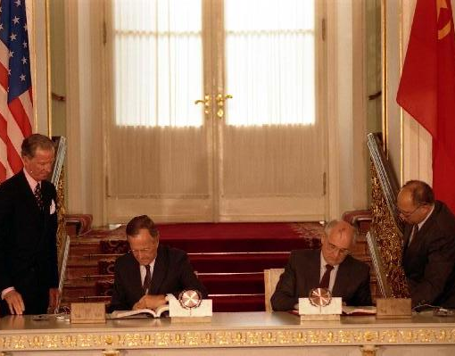
The End of the Cold War
Dr Jonathan Leader Maynard
jonathan.leader_maynard@kcl.ac.uk
www.jleadermaynard.com @jleadermaynard

Slide 2
Explanations of the End
 | Material | Ideational
Internal | Soviet Economic Decline (Brooks and Wohlforth) | Gorbachev’s New Thinking (English)
External | Reagan’s Strategic Buildup (Nau) Globalization (Broosk & Wohlforth) | Reagan’s Ideological Challenge (Nau) Liberal Ideas (Risse; Deudney & Ikenberry) Human Rights Norms (Thomas)
To what extent were ideas endogenous to material forces or vice versa?
How crucial were the individual leaders – principally Reagan and Gorbachev?
What other paths might the USSR have taken?

Slide 3
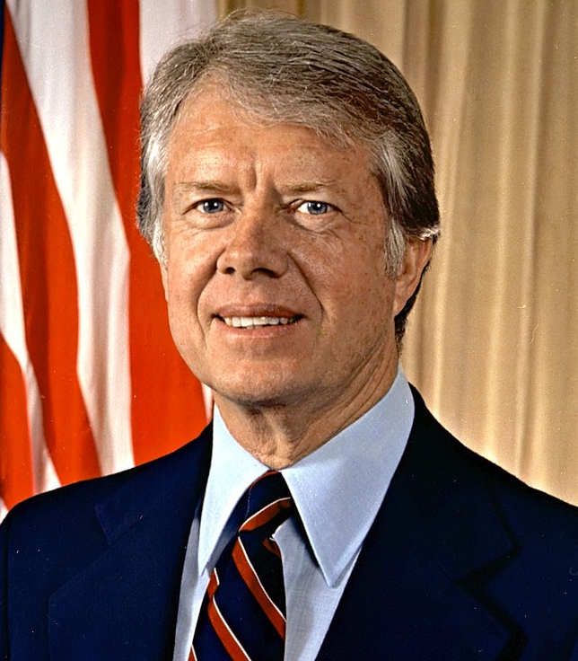
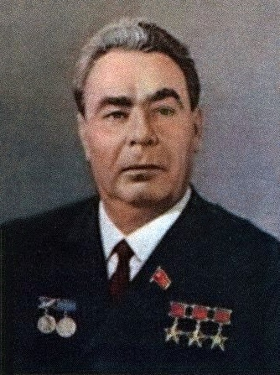
The Decline of Détente 1975-79
USSR cancels 1972 Trade Agreement (1975)
USSR and Cuba install Communist regime in Angola (1975-6)
New Carter administration sees breakdown in arms talks and increased US focus on Human Rights (1976)
USSR completes development of new RSD-10 intermediate range nuclear missiles, and deploys them in the European theatre (1976 onwards)
Left-wing government takes over in Ethiopia and aligns with USSR (1977), USSR and Cuba lend military assistance in subsequent conflict with Somalia (1978)
SALT II Treaty signed, though never ratified (1979)
NATO decides to deploy Pershing nuclear missiles in Europe (1979)
USSR invades Afghanistan (Dec 1979)
Jan 77-Jan 81
Oct 64-Nov 82

Slide 4
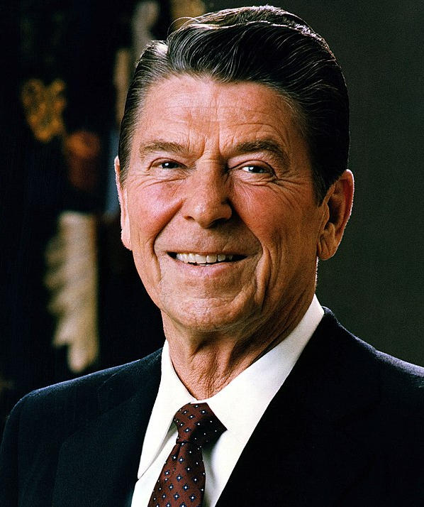
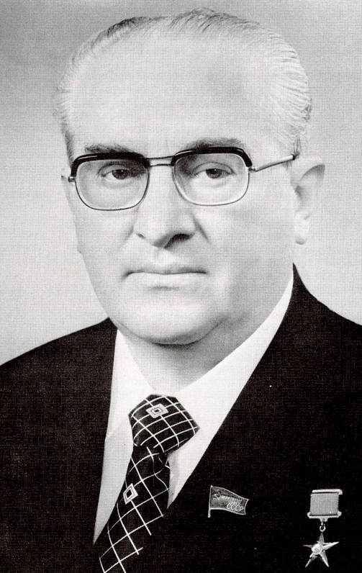
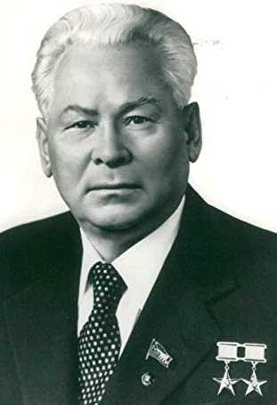
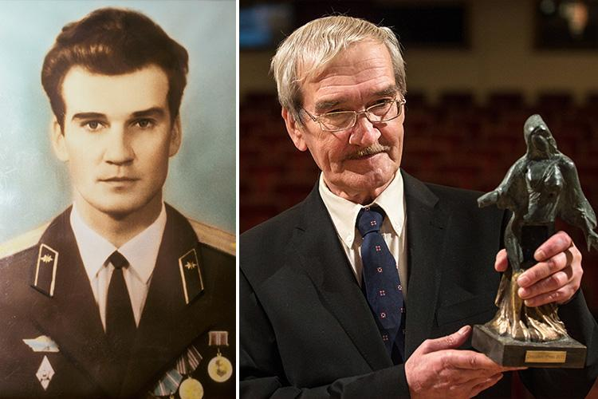
The Decline of Détente 1980-85
US withdraws from SALT II, and Western states boycott Moscow Olympics in protest against invasion of Afghanistan (1980)
The Polish Crisis (1980-81)
Reagan takes office amid increased anti-Soviet rhetoric (1981)
USSR cancels INF and START talks in response to NATO missile deployments in Europe (1983)
Reagan calls for the Strategic Defence Initiative (1983)
USSR shoots down a Korean passenger aircraft (Sep 1983)
Soviet Nuclear False Alarm incident and Able Archer 83 Crisis (Sep and Nov 1983)
Chernenko dies (Mar 1985)
Jan 81-Jan 89
Nov 82- Feb 84
Feb 84- Mar 85

Slide 5
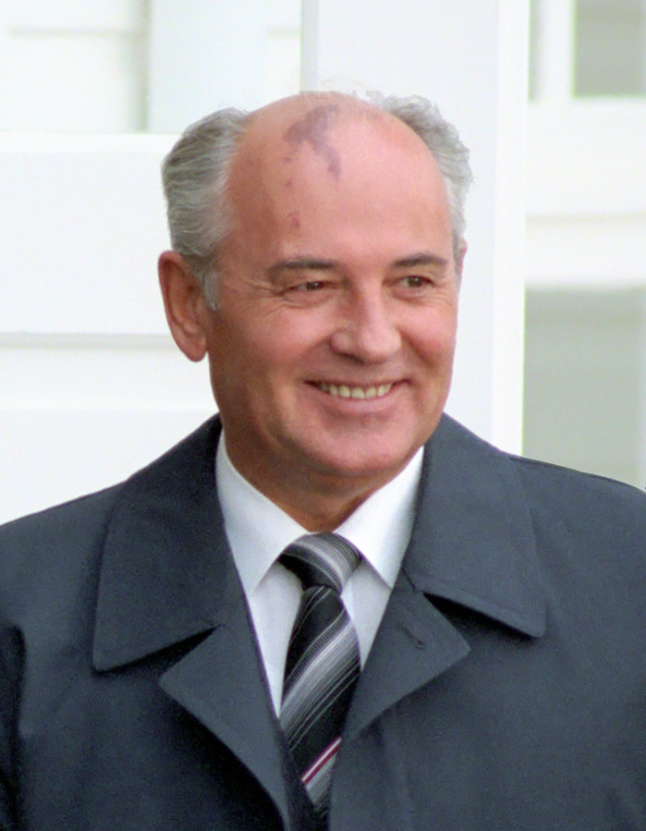
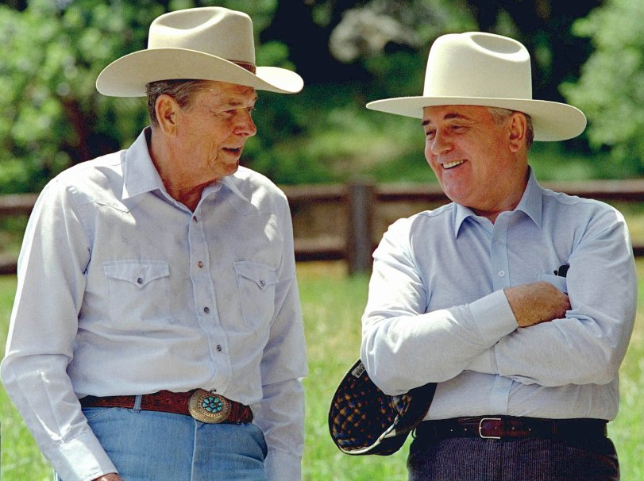
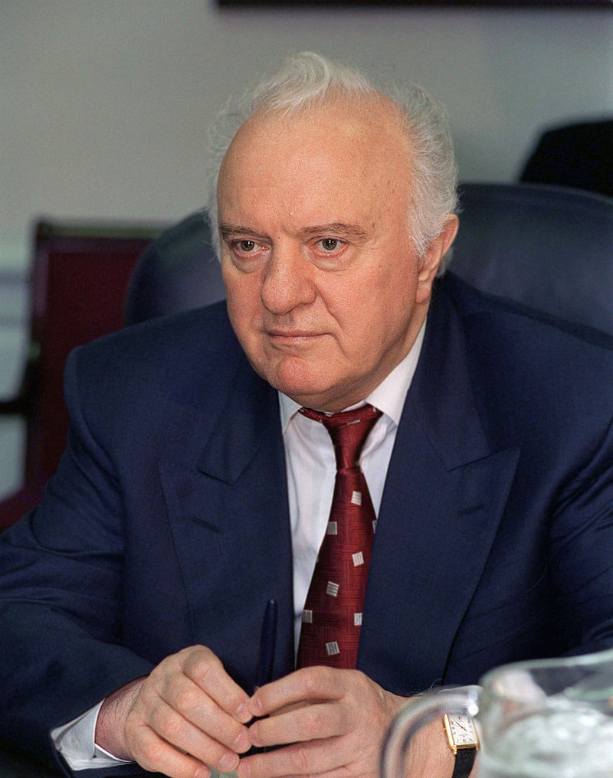
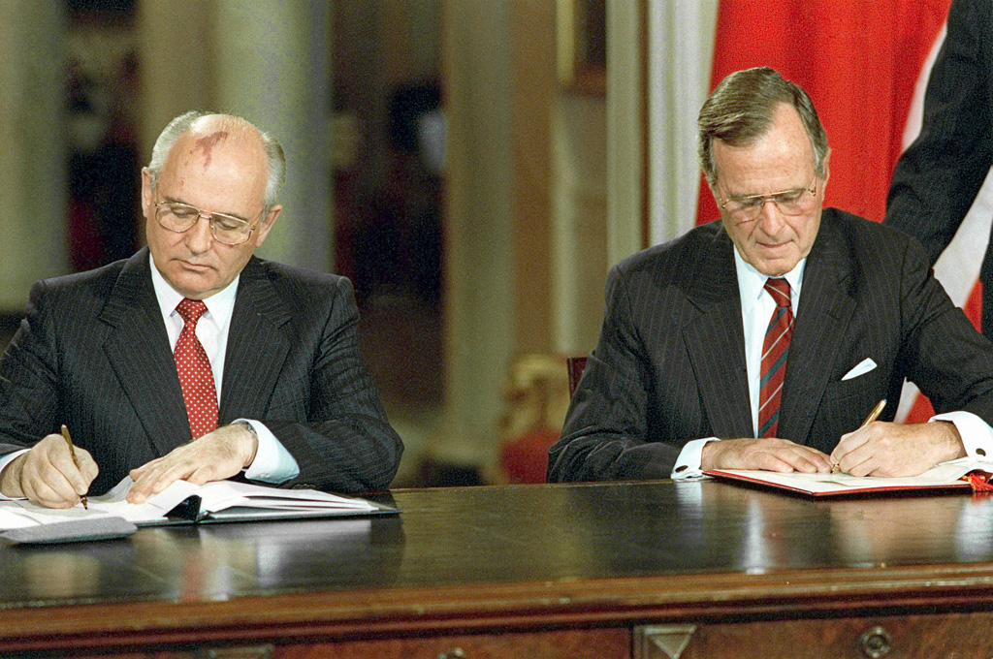
The Gorbachev Revolution
Visit to UK and meeting with Thatcher (1984)
Nuclear Moratorium (Jul 1985)
Proposes global abolition of nuclear weapons (1986)
INF Treaty negotiations (1986-7)
Chernobyl Explodes (1986)
Thatcher visits Moscow (1987)
Freezes Defence Spending (1987)
Promises withdrawal from Afghanistan (1987)
Releases political dissidents (1987-8)
Political reforms (1988-90)
Suggests pan-European disarmament (1988)
Mar 85- Aug 91
Gorbachev
UN speech announces unilateral military cuts and calls for solution to world debt (Dec 1988)
Withdraws troops from E. Europe (1989)
Fall of the Berlin Wall (Nov 1989)
Warsaw Pact dismantled (Apr 1991)
START I Treaty signed (Jul 1991)
Shevardnadze

Slide 6
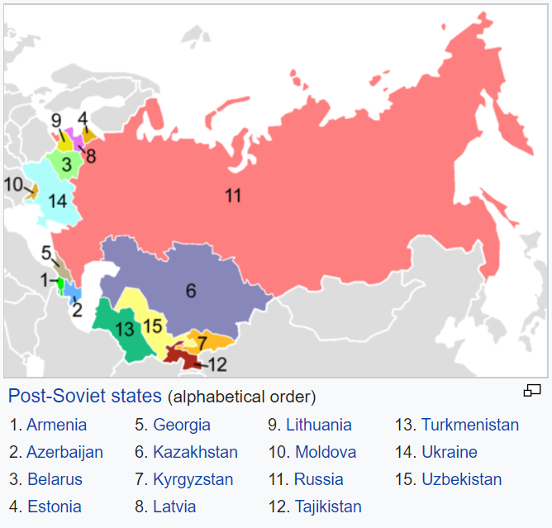
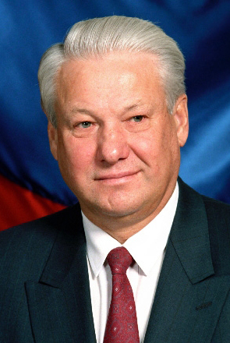
The Collapse of the Soviet Union
Free elections for local and republic-level Soviets (Early 1990)
Baltic States push for independence (Early 1990)
Boris Yeltsin becomes President of Russian Republic (May 1990)
Gorbachev reconstitutes a reactionary cabinet (Dec 1990)
Republics hold back contributions to Soviet budget (early 1991)
Failed reactionary coup against Gorbachev and Yeltsin (Aug 1991)
Yeltsin bans Communist Party in Russia (Aug 1991)
Republics declare independence (Aug-Dec 1991)
Russia, Ukraine and Belarus sign the Belavezha Accords, dissolving the USSR and creating the Commonwealth of Independent States (Dec 1991)

Slide 7
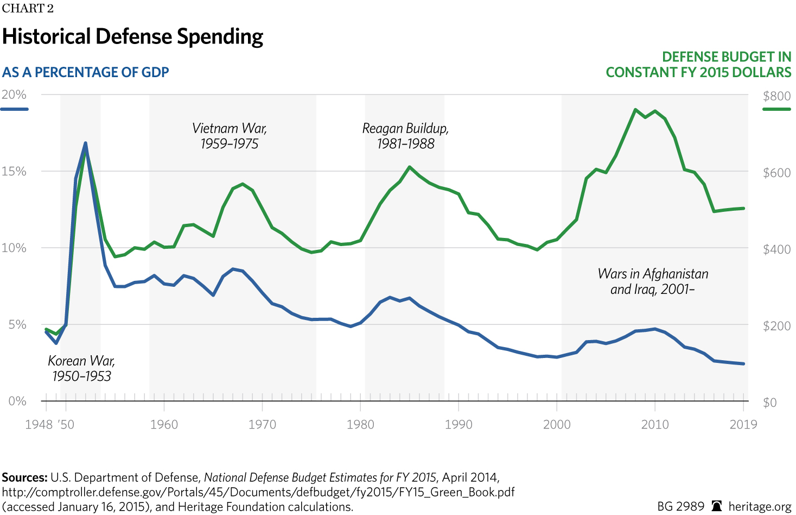
The US Contribution
Initial focus under Reagan on military build-up and Latin America – seeking to overthrow the Sandanistas in Nicaragua (1981-90)
Condemnation of suppression of Solidarity in Poland (1981)
Psychological Operations against the USSR (Feb 1981-1983)
British House of Commons and ‘Evil Empire’ Speeches (Jun 1982 and Mar 1983)
Reagan announces the Strategic Defense Initiative (Mar 1983)
Escalates US support to insurgency in Afghanistan (1985)
Simultaneously offers USSR negotiations (1981-85).
Notes:
Chart from: https://www.dailysignal.com/2015/02/14/history-defense-spending-one-chart/

Slide 8
Explanations of the End
 | Material | Ideational
Internal | Soviet Economic Decline (Brooks and Wohlforth) | Gorbachev’s New Thinking (English)
External | Reagan’s Strategic Buildup (Nau) Globalization (Broosk & Wohlforth) | Reagan’s Ideological Challenge (Nau) Liberal Ideas (Risse; Deudney & Ikenberry) Human Rights Norms (Thomas)
To what extent were ideas endogenous to material forces and vice versa?
How crucial were the individual leaders – principally Reagan and Gorbachev?
What other paths might the USSR have taken?
What was the key role for ideas: sincere convictions or instrumental tools?

Slide 9

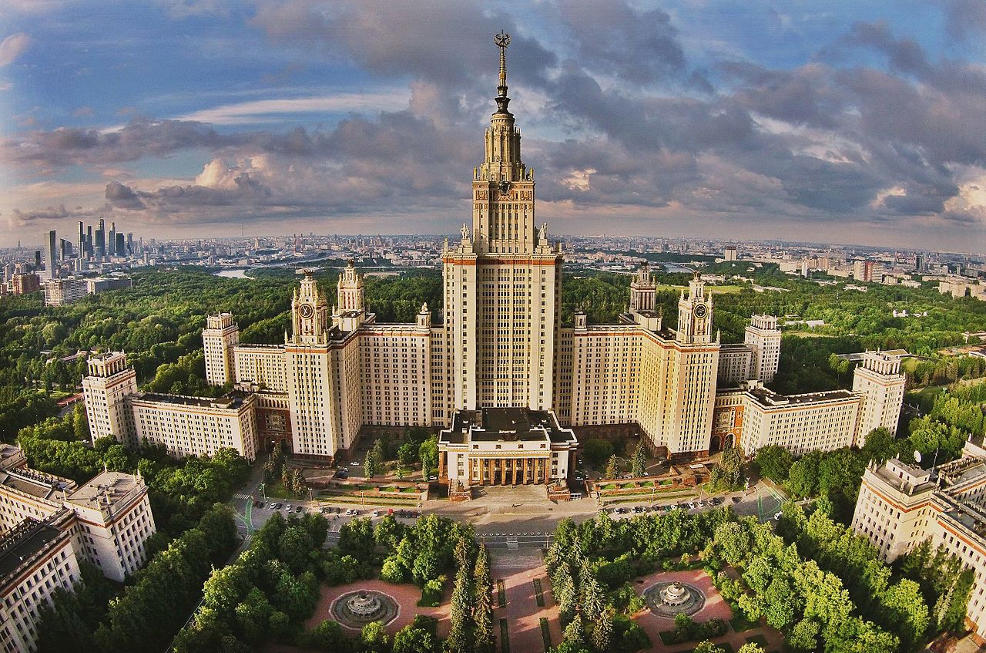
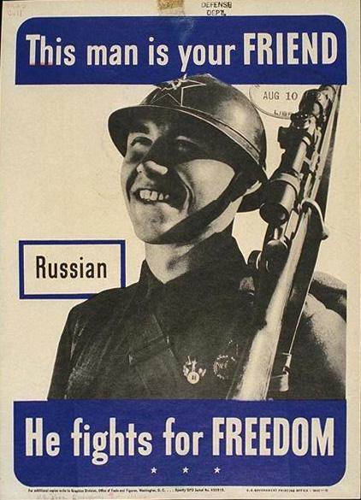

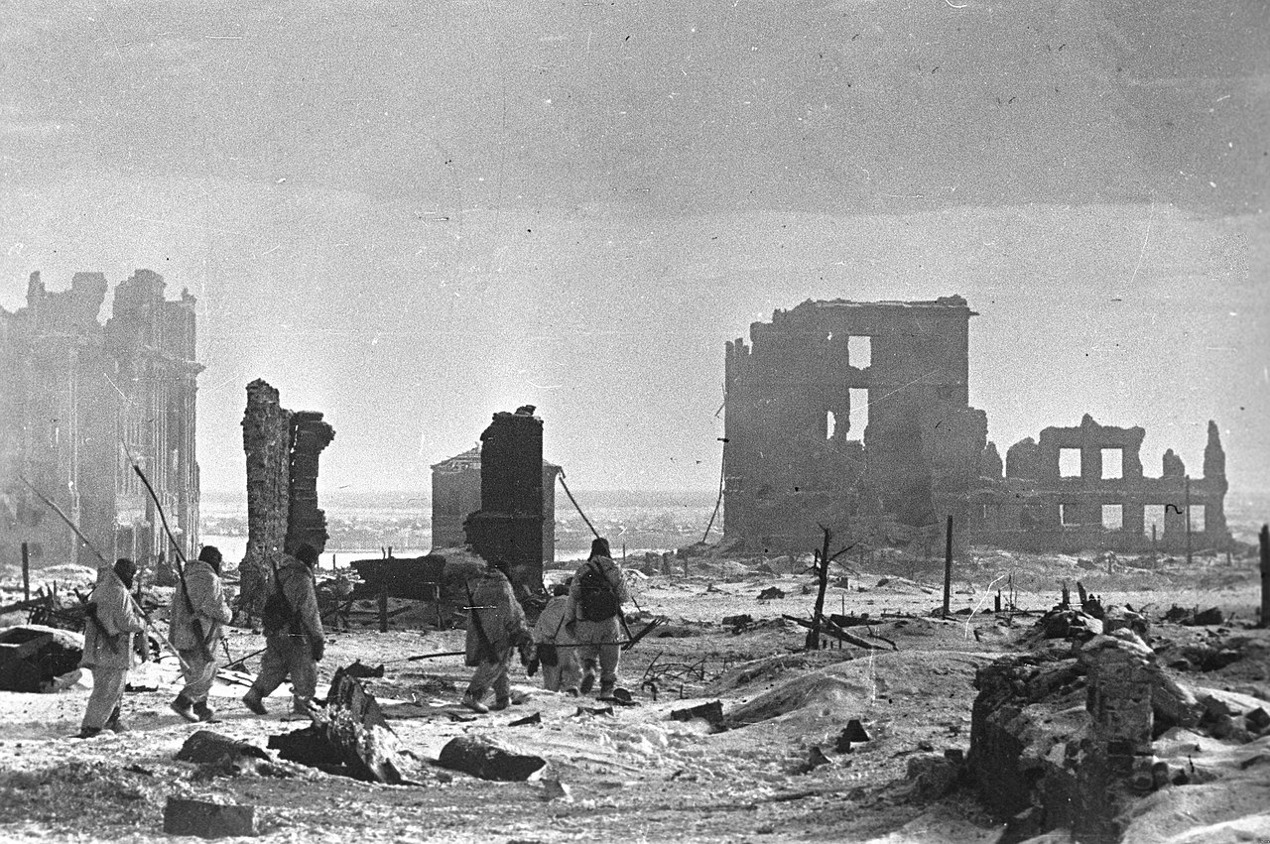
Remembering the Soviet Union
Notes:
Moscow Metro photo by Andrey Kryuchenko, available at: https://en.wikipedia.org/wiki/Moscow_Metro#/media/File:Vertical_panorama_of_the_Mayakovskaya_Metro_Station.jpg
Moscow State University photo by I.s.kopytov, available at: https://en.wikipedia.org/wiki/Moscow_State_University#/media/File:%D0%9C%D0%93%D0%A3,_%D0%B2%D0%B8%D0%B4_%D1%81_%D0%B2%D0%BE%D0%B7%D0%B4%D1%83%D1%85%D0%B0.jpg

